Slide 1
Alaska State Council Meeting
SHRM Update
February 15, 2014
Dianna Gould, SPHR, CAE
PW Field Services Director

Slide 2
Volunteer Structure
SHRM® Board
Governance Committee*
Membership
Advisory Council
HR Expertise Networks
Ethics
Global
Labor Relations
Workplace Diversity
HR Technology
HR Disciplines – Includes:
Talent Management, Compensation, Benefits, Organizational Development, Employee Relations, Employee Health, Safety & Security
Regional
Councils
Members
State
Councils
Local
Chapters
Staff Support
Notes:
SHRM is “profession-focused, member-driven, volunteer-led, and staff-managed.”
The very structure of SHRM and the involvement of the volunteer leaders support this position.
Each of these entities plays an integral part in the success of SHRM – let’s talk about each one in more detail.

Slide 3
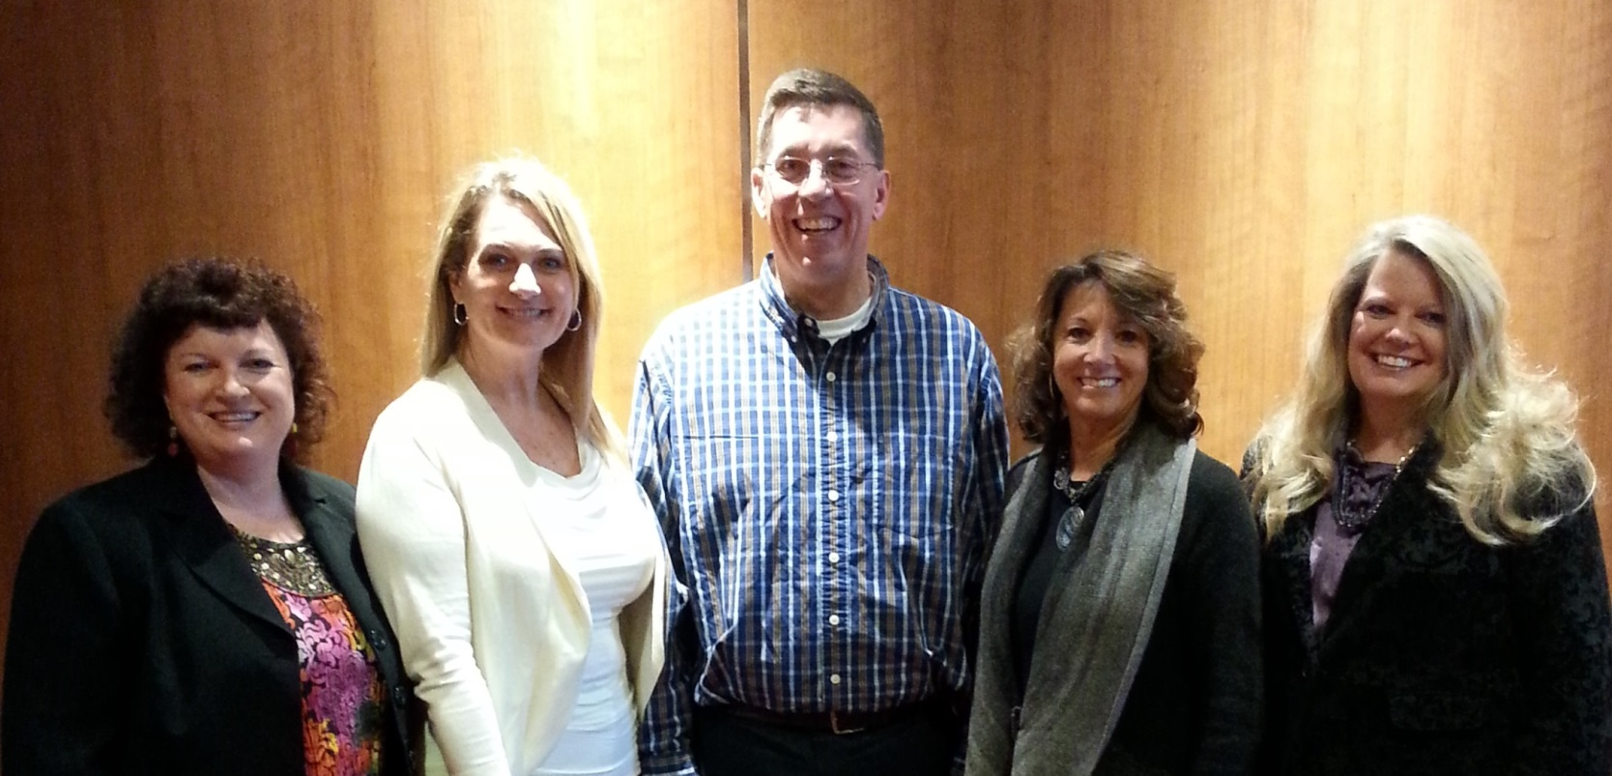
2014 Membership Advisory Council
Left to Right
Southeast Region: Paula Harvey, SPHR, GPHR
Southwest Central Region: Rebecca Briley
North Central Region: Steve Browne, SPHR
Pacific West Region: Debbie Horne, SPHR
Northeast Region: Kristine Avery, SPHR

Slide 4
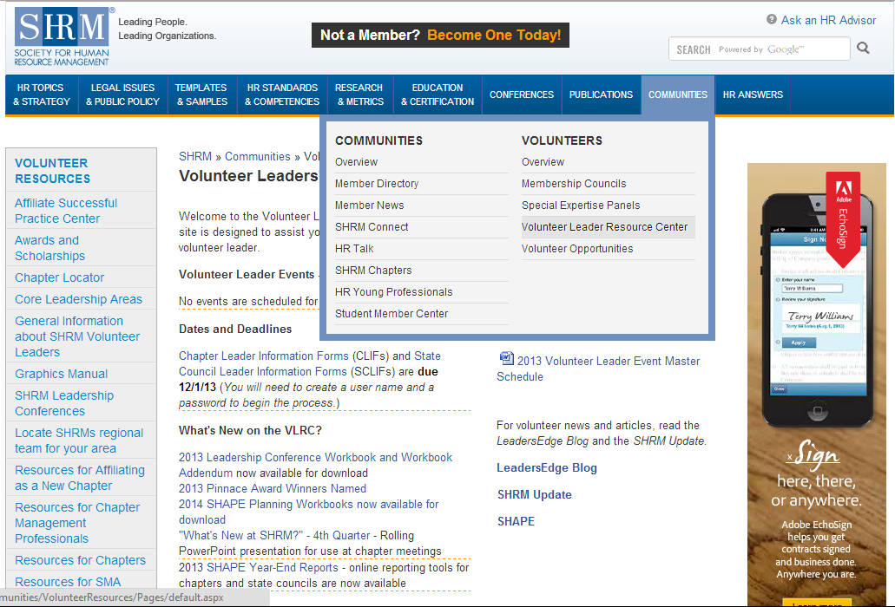
Volunteer Leader Resource Center (VLRC)
www.shrm.org/vlrc

Slide 5
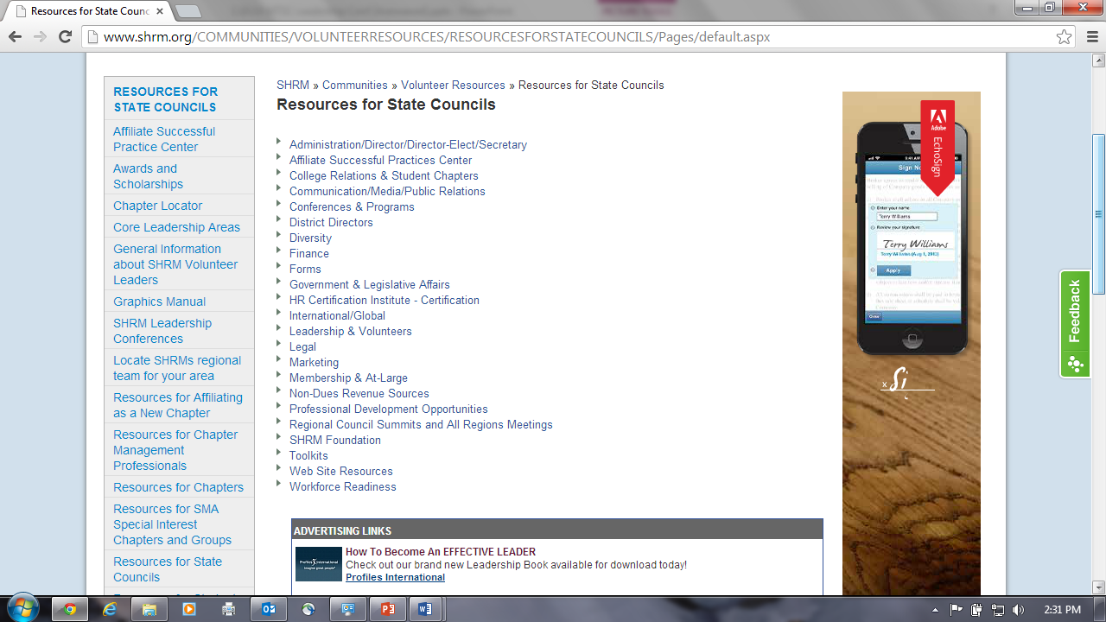
VLRC: Resources for State Councils & Chapters
Resources for every volunteer role – don’t reinvent the wheel!

Slide 6
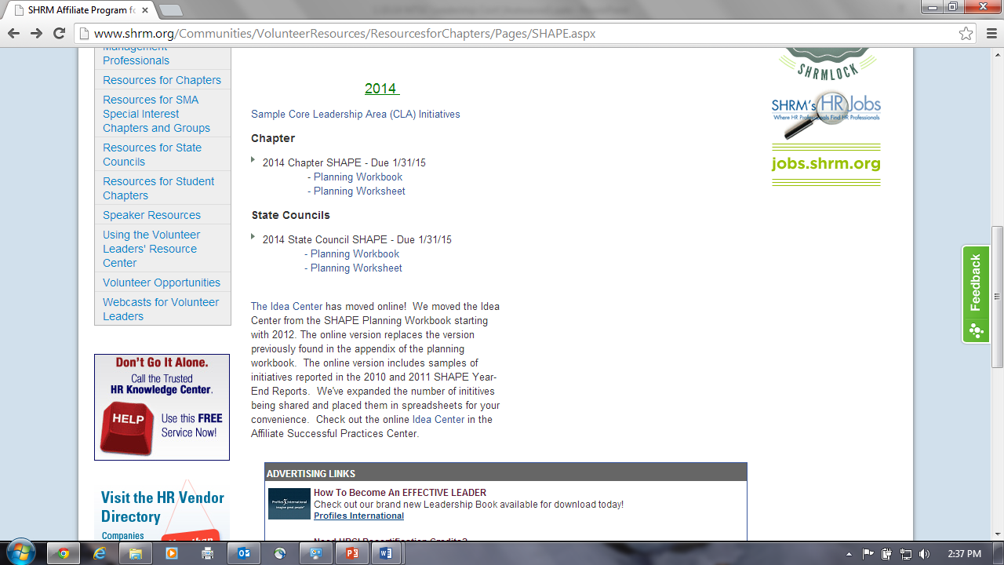
VLRC: Core Leadership Areas
http://www.shrm.org/Communities/VolunteerResources/ResourcesforChapters/Pages/SHAPE.aspx

Slide 7
Use of the SHRM Affiliate Logo
Must be used correctly at all times
Graphics Standards Manual for Affiliates
New Sections added
  Chapter and State Council Award Logos
  Membership Star and Superstar Award Logos
  100 Percent Chapter and State Council Logos
  Chapter and State Council Logos

Slide 8
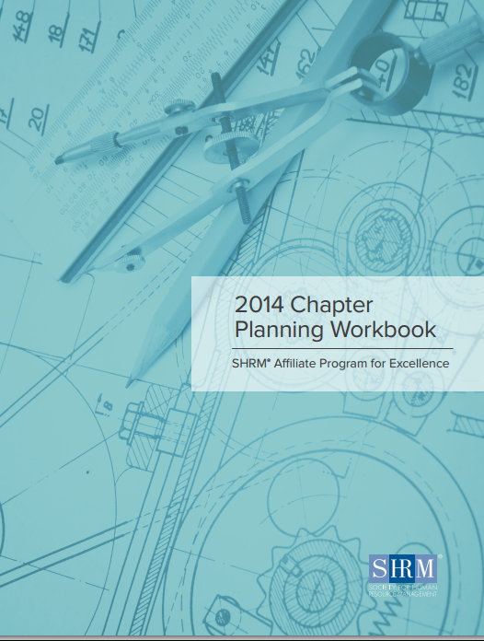
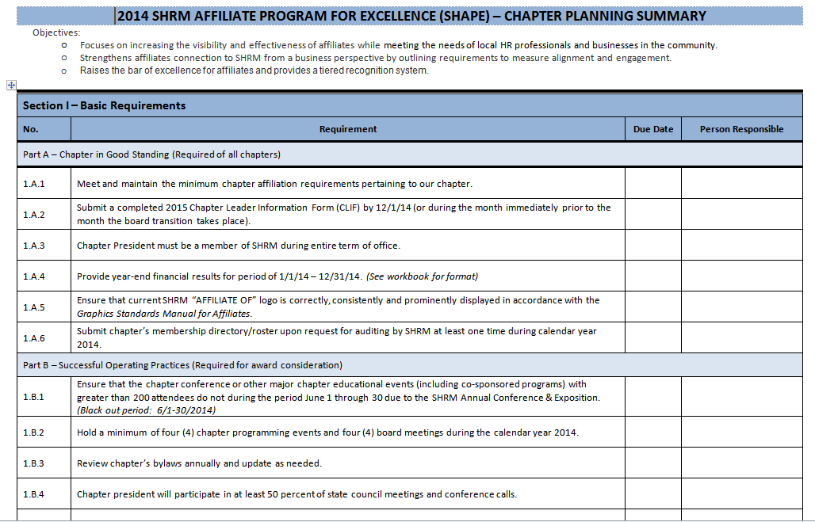
SHRM Affiliate Program for Excellence
SHAPE
Both a planning tool and an evaluation tool
Covers calendar year
Reporting tool for SHAPE award
Must be filed with SHRM by 1/31 to receive CFSP
Need to determine now who will complete
Complete online only
2014 Planning book and worksheet available

Slide 9
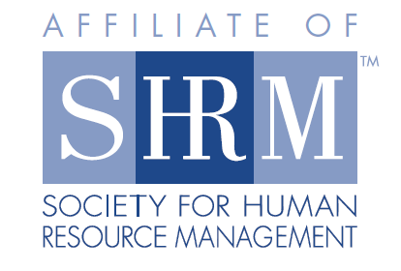

Which is correct?
Check your entire website, all documents, etc.

Slide 10


Membership Award Status
1% - 3.99%
STAR
4% or more
SUPERSTAR

Slide 11
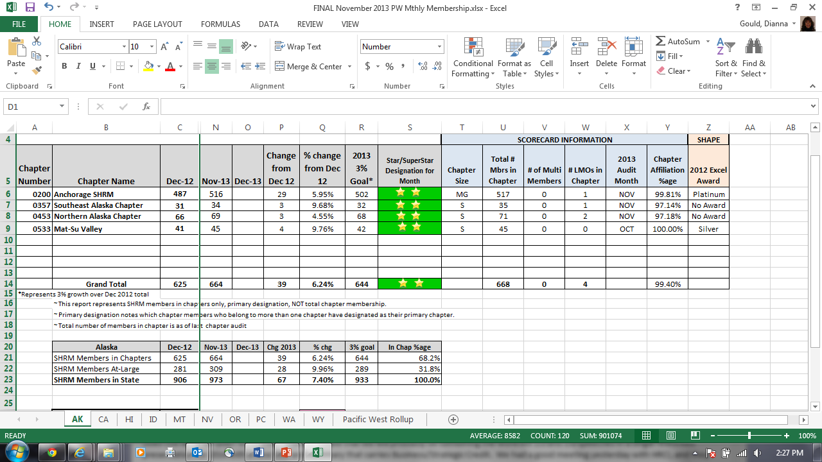
Monthly Membership Reports
Sent to State Council Directors, State Council Membership Directors, Chapter Presidents & CMPs
At the bottom of the report are tabs for each state in the region. Compare year-end numbers with current month. Also note member growth/loss and percent change. PLEASE NOTE that LMO numbers are captured only ONCE per year, during the audit. LMO numbers on this report will NOT CHANGE.
Notes:
At-large Members
At-large member is an individual who is a member of SHRM but is not affiliated with a local chapter.
Recruiting at-large members to your chapter is a great way to increase SHRM membership in your chapter.
Online membership application includes a required field for indicating chapter membership.
Local Members Only (LMOs)
An LMO is an individual who belongs to a local chapter but is not a SHRM member.
Promote benefits of joining SHRM to your LMOs.
Discount offered to first-time SHRM members via a promotional code (0118).
Strengthens partnership between SHRM and the chapter.
Primary Members
Member of more than one chapter (multi-member) who designates one chapter as the primary chapter (this chapter receives CFSP for the member).
Multi-Members
Member of SHRM who maintains membership in multiple chapters. Primary chapter affiliation is with another SHRM affiliate chapter. A chapter would receive credit for chapter affiliation percentage purposes for multi-members but not for CFSP
Primary Chapter Designation Form submission deadline – NEW!
From January – November, CDFs must be received by the 5th business day prior to the end of the month to be processed.
For December, must be received by December 15th to be processed by the end of the year.
While a SHRM member may belong to more than one affiliated chapter, only one chapter may be designated as that member's primary chapter. The member is free to change that designation as he/she wishes. Primary Chapter Designation Forms are signed directives from the member to SHRM authorizing SHRM to change his/her primary chapter designation.
The form is completed by the member and faxed or emailed to SHRM. Upon receipt of the executed form, the member's primary chapter will be changed. To ensure changes are made during the appropriate month, submission deadlines are in place.

Slide 12
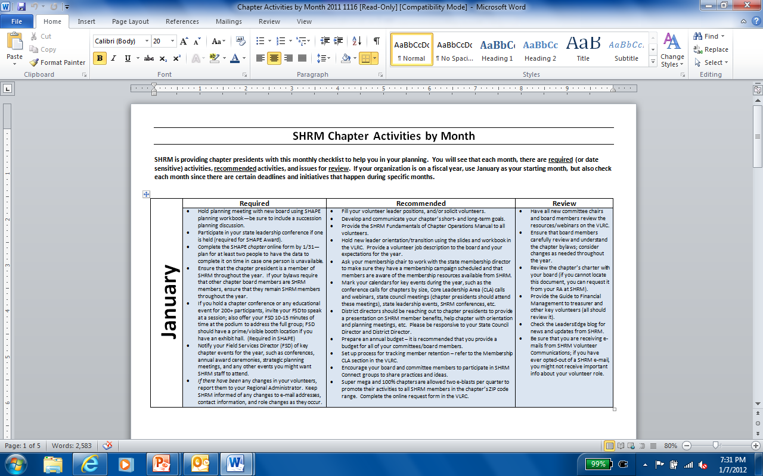
RESOURCES: VLRC: Chapter Activities Checklist by Month
Under Administration/President . . .

Slide 13
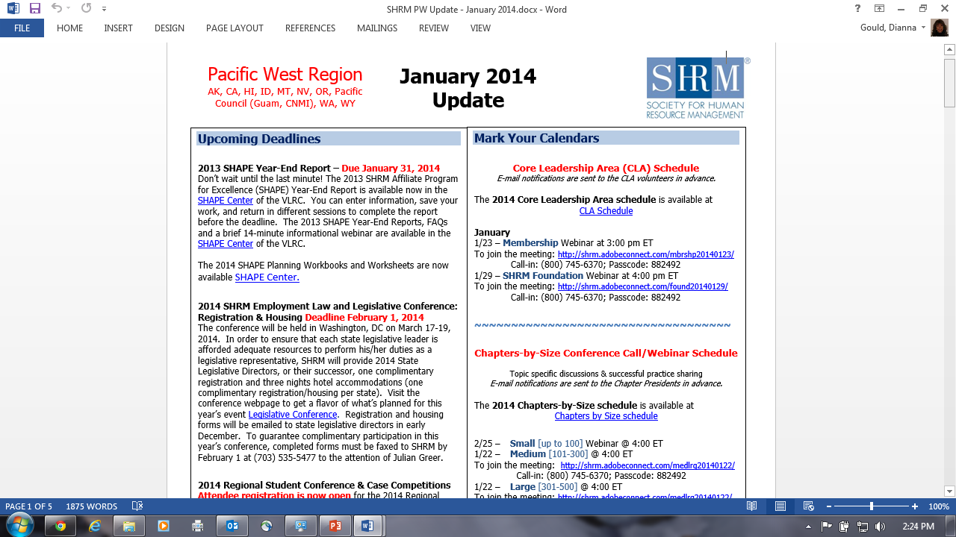
RESOURCES: SHRM Monthly Update
Watch for this report to come each month from Nancy Miller. Look for conference call & webinar dates, upcoming deadlines, important volunteer news from SHRM, upcoming events and conferences, new SHRM-member benefits, and contact information.
Read each month!

Slide 14
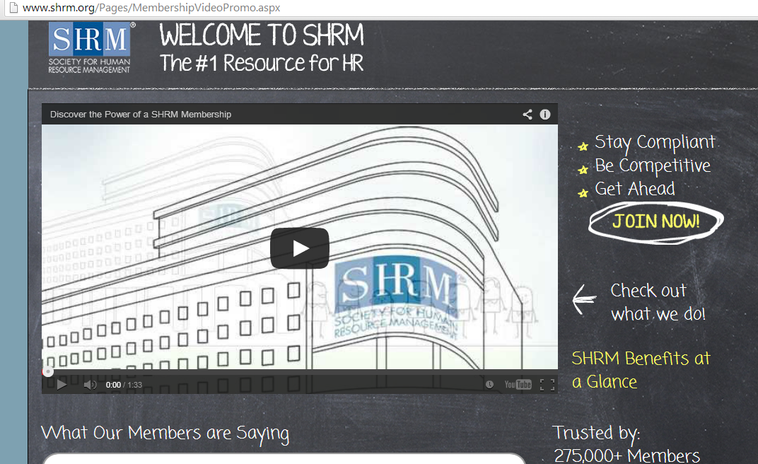
SHRM – Membership Cartoon
www.shrm.org/cacartoon

Slide 15
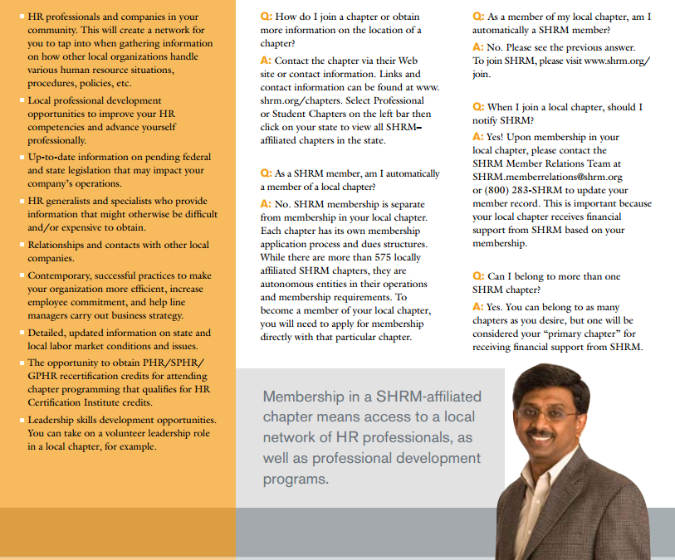
Chapter Affiliation Brochure
Brochure is free to chapters and downloadable to handout at meetings
Explains the value of chapter membership to SHRM members
Use it to contact at-large members to invite them to become chapter members

Slide 16
SHRM Foundation DVD Series
Pre-approved for HRCI credit as Chapter Program
NEW! From Local to Regional to Global Player: The Evolution of Aramex (Global)
Dollar General: Serving Others--Dollar General's Commitment to the Military Community (HR credit)
Ernst and Young: Creating a Culture of Flexibility (HR credit)
Doing Well by Doing Good: Global Sustainability at Aditya Birla Group (Business or Global credit)
Once the Deal is Done: Making Mergers Work (Business credit)
World Economic Forum: Creating Global Leaders (Business or Global credit)
Seeing Forward: Succession Planning at 3M (HR credit)
Trust Travels: The Starbucks Story (Business credit)
Ethics- The Fabric of Business (Business credit)
Fueling the Talent Engine-Finding and Keeping High Performers(Business credit)
HR in Alignment: The Link to Business Results
HR Role Models
www.shrm.org/about/foundation/products/Pages/SHRMFoundationDVDs.aspx

Slide 17
What’s New at HRCI
Recertification Policies and Procedures Updates
The Birthday Rule
Recertification Fee Change from $100 to $150
Specified Credit Terminology Changes
“Suspended” status
New Recertification System Updates
Recertification Learning Plan
Email address as user ID
Immediate notification for audit selection
Helpful Resource

Slide 18
What’s New at HRCI
Helpful Resource
Created the Info Hub
http://www.hrci.org/hrci-info-hub
Contains videos and step-by-step guides to walk-through the new recertification system

Slide 19
Pre-Approved Program Reminders
  Programs must be at least 1 hour in duration
  Programs must focus on professional development, not personal development
  Programs must have a direct tie to the HR Certification Institute’s Knowledge Bases
  Programs must have clear learning objectives
  Programs must be submitted for review at least 4 weeks prior to the event start date
    At any given time, there are 500+ submissions in queue
  Programs lasting over 3 hours, must have a detailed agenda included in the submission

Slide 20
Pre-Approved Program Reminders (cont.)
  Remember – if the host organization knows their event has been pre-approved in the past or by another organization – reference this information during the submission process
  Programs are only valid during the year they are submitted – if there is a popular event that is offered each year, make sure it is submitted early
  Make sure attendees are provided with documentation of the program/program ID, in the event their recertification application is audited

Slide 21
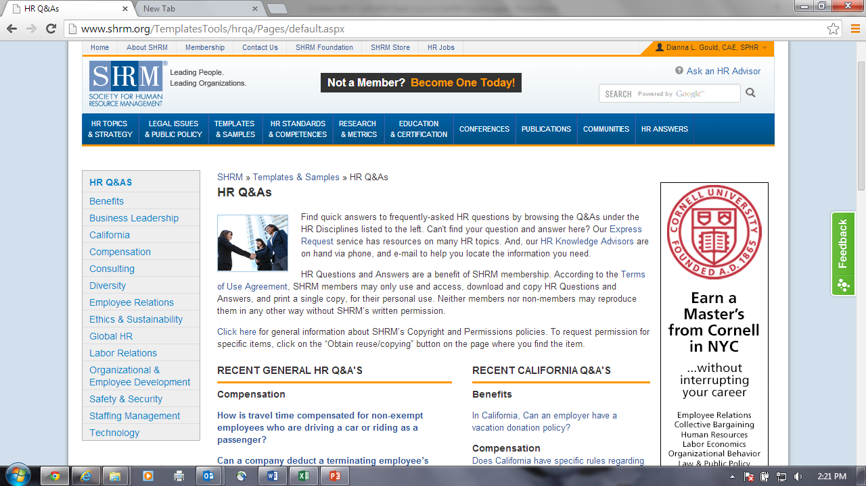
HR Q & A’s
Knowledge Development Division

Slide 22
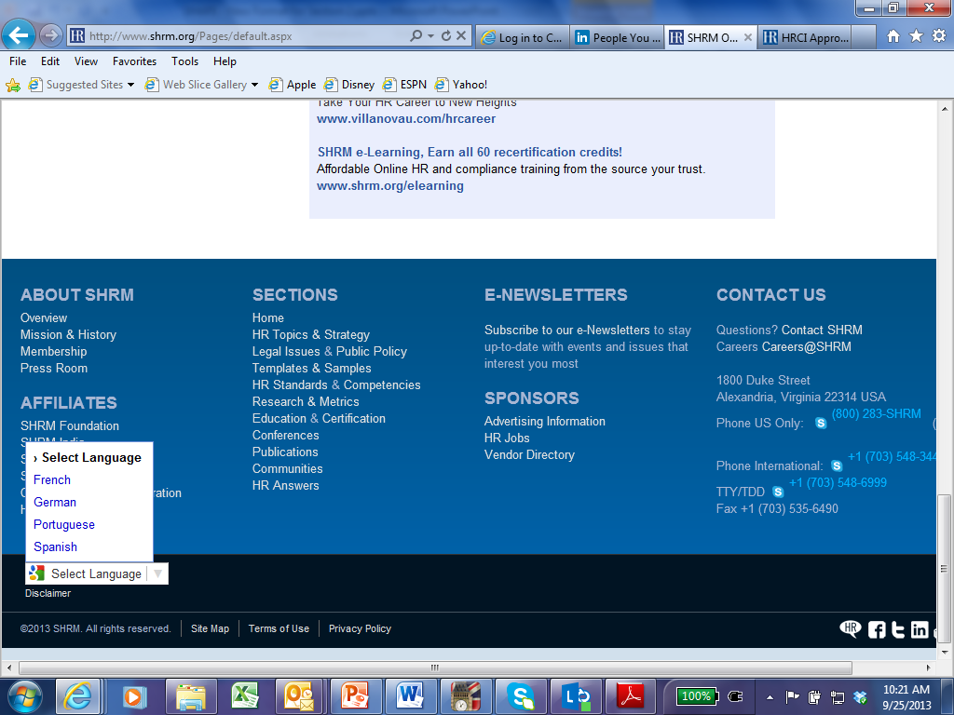
SHRM website available in FIVE Languages
Shrm.org - landing page

Slide 23
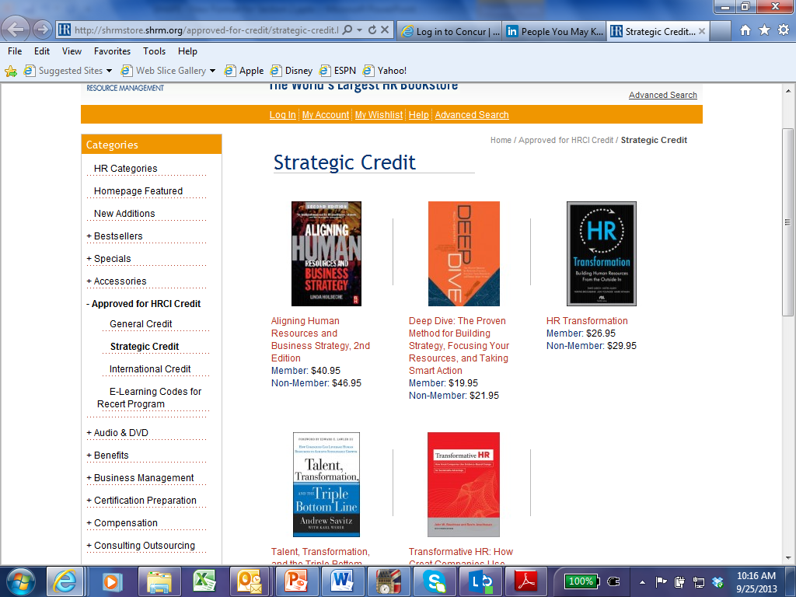
New Books for Strategic HRCI Recertification Credits
http://shrmstore.shrm.org/approved-for-credit/strategic-credit.html
Notes:
HRCI/ SHRMStore Recertification Credit Program
The HRCI/ SHRMStore Recertification Credit Program is an important way to broaden your HR knowledge and receive recertification credit in the process. Below are some of the most frequently asked questions on the HRCI/ SHRMStore Recertification Credit Program.
1. How many credits can I earn using the program?
You can earn 2.5 credits per book. The total allowable credits in a three-year certification cycle is 20 credit hours.
2. What kind of credits do I receive for reading the select HR books?
Each book counts towards your continuing education activities. Some books carry General Credit while others are approved for Strategic and Global Credit.
3. Do I have to buy the book from the SHRMStore?
No, you can purchase the book through alternate sources, including book loans from local or online libraries. However, to receive the credit, you will need to purchase an e-learning quiz code. You can purcase them from the SHRMStore. Visit our e-learning code page.
4. Can I read the e-book and still receive the credit?
Yes, you can read e-books and receive recert credits. However, to receive the credit, you will need to purchase an e-learning quiz. You can purcase them from the SHRMStore. Visit our e-learning code page.
5. How do I receive the recertification credits?
When you purchase the book from the SHRMStore, you will receive a learning code for SHRM’s e-learning system.
After you read the book, you will use the learning code to take a quiz that tests your knowledge of the book’s content.
Go to www.shrm.org/elearning.
Log in or create a new account
Search for the test by entering the title of the book you have read.
Take the test. You have two opportunities to pass. Also, the test must be completed in one sitting. You cannot log out and log back in to resume the test. If you have not completed the test and log out, you will receive a failing grade. There is no time limit to taking the test. However, it must be completed in one sitting.
If you receive a 70%+ passing grade you are eligible to claim the book for credit. Once you pass the test, you will receive a Program ID that can be logged to claim credit.
6. How long after reading the book do I have before I can take the test?
You will receive the learning code for the book quiz after purchasing the book. You can access the test immediately. Note: You are only allowed two opportunities to pass the test.
7. How do I know if I passed the test?
You will receive a pass/ fail notification when you complete the test. Note: You have only two opportunities to pass the test.
8. How do I report my credits?
Record your credits in your Online Profile. You will use the program ID provided at the time you complete and pass the test. For more information on recording credits, visit HRCI’s “Applying for Recertification Online” page.
9. How do I know which books are authorized for general, strategic or global credits?
Each book indicates the credit qualifications. In addition, the test will indicate which credit the book carries. For a list of the books approved for credit, visit http://shrmstore.shrm.org/recert/approved-books.html.
10. What if I lose/ misplace my promo code for the e-learning program?
You can email the SHRMStore at shrmstore@shrm.org to have a copy of your e-learning promo code email resent to you. Please allow 48-72 hours to receive the replacement promo code.

Slide 24
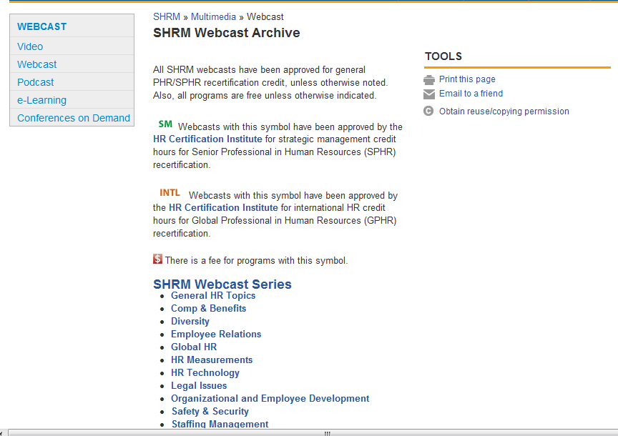
Free HRCI Recertification Credits
http://www.shrm.org/multimedia/webcasts/Pages/archive.aspx

Slide 25
In-Transition Membership
Please share with your members
SHRM offers a one-time-only benefit of a free one-year continuation of membership to any current member who has been downsized
Must already be a member of SHRM
Contact SHRM’s Member Care Department for more information
Consider offering this option to your own members – great for retention!

Slide 26
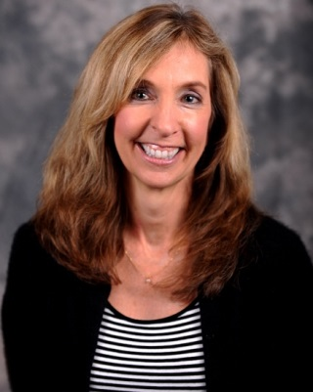
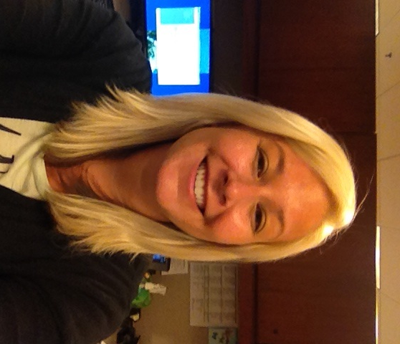
RESOURCES: Pacific West Regional Contacts
Dianna Gould, SPHR ,CAE
Dianna.gould@shrm.org
(800) 283-7476, x 6267
703-535-6267
Kim Goodwin
Kimberly.goodwin@shrm.org
(800) 283-7476, x 6316
703-535-6316
Notes:
And, serving as your emcee for the conference is …………

Slide 27

Thank you!
Dianna Gould, SPHR, CAE dianna.gould@shrm.org
1-800-283-7476, Option 1, X6267
Image courtesy of Stuart Miles/FreeDigitalPhotos.net

